Slide 1
Eigenvalues and Eigenvectors

Slide 2
Eigenvalues and Eigenvectors
The vector x is an eigenvector of matrix A and λ is an eigenvalue of A if: Ax= λx
Eigenvalues and eigenvectors are only defined for square matrices (i.e., m = n)
Eigenvectors are not unique (e.g., if λ is an eigenvector, so is k λ)
Zero vector is a trivial solution to the eigenvalue equation for any number λ and is not considered as an eigenvector.
Interpretation: the linear transformation implied by A cannot change the direction of the eigenvectors λ, but change only their magnitude.
(assume non-zero x)

Slide 3





We summarize the computational approach for determining eigenpairs (λ, x) (eigenvalues and eigen vector) as a two-step procedure:
Example: Find eigenpairs of
Step I. Find the eigenvalues.

Slide 4

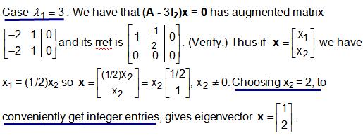
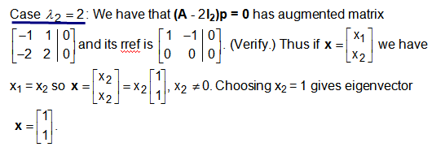
The eigenvalues are
Step II. To find corresponding eigenvectors we solve
(A - λ_{i}I_{n})x = 0 for i = 1,2
Note: rref means row reduced echelon form.

Slide 5

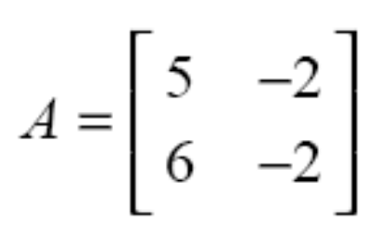
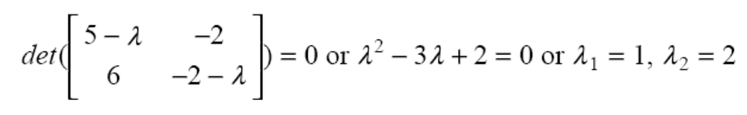
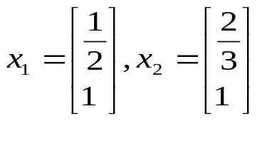
Computing λ and v
To find the eigenvalues λ of a matrix A, find the roots of the characteristic polynomial :
Ax= λx
Example:

Slide 6
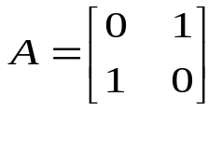
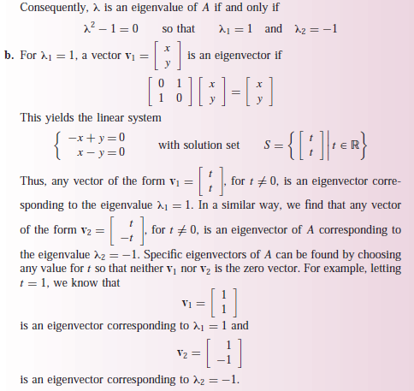
Example: Find eigenvalues and eigen vectors of
The characteristic polynomial is

Slide 7




Example:
Find the eigenvalues and corresponding eigenvectors of
The characteristic polynomial is
Its factors are
So the eigenvalues are 1, 2, and 3.
Corresponding eigenvectors are

Slide 8
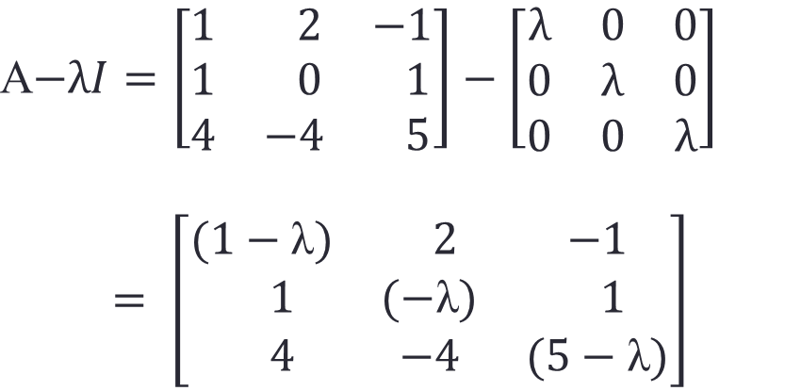

By using the third column,

Slide 9
